Slide 1
Copyright © 2011 Pearson Education, Inc. publishing as Prentice Hall
Notes:
Human Resources Management 12e
Gary Dessler
Copyright © 2011 Pearson Education, Inc. publishing as Prentice Hall
1–<number>

Slide 2

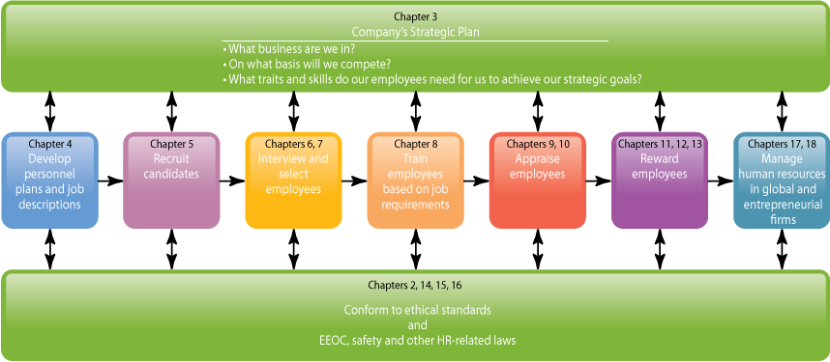
WHERE WE ARE NOW…
Copyright © 2011 Pearson Education, Inc. publishing as Prentice Hall
1–<number>
Notes:
Human Resources Management 12e
Gary Dessler
Copyright © 2011 Pearson Education, Inc. publishing as Prentice Hall
1–<number>
The purpose of this chapter is to explain what human resource management is, and why it’s important to all managers.
We’ll see that HRM activities such as hiring, training, appraising, compensating, and developing employees are part of every manager’s job. And we’ll see that HRM is also a separate function, usually with its own human resource or “HR” manager.
The main topics we’ll cover include the meaning of human resource management; why HRM is important to all managers; global and competitive trends; HRM trends; and the plan of this book. The framework (which introduces each chapter) makes this point: That to formulate and apply HR practices like testing and training you should understand the strategic and legal context in which you’re managing.

Slide 3
LEARNING OUTCOMES
Explain what human resource management is and how it relates to the management process.
Show with examples why human resource management is important to all managers.
Illustrate the human resources responsibilities of line and staff (HR) managers.
Briefly discuss and illustrate each of the important trends influencing human resource management.
List and briefly describe important trends in human resource management.
Define and give an example of evidence-based human resource management.
Outline the plan of this book.
Copyright © 2011 Pearson Education, Inc. publishing as Prentice Hall
1–<number>
Notes:
Human Resources Management 12e
Gary Dessler
Copyright © 2011 Pearson Education, Inc. publishing as Prentice Hall
1–<number>

Slide 4
Human Resource Management at Work
What Is Human Resource Management (HRM)?
  The process of acquiring, training, appraising, and compensating employees, and of attending to their labor relations, health and safety, and fairness concerns.
Organization
  People with formally assigned roles who work together to achieve the organization’s goals.
Manager
  The person responsible for accomplishing the organization’s goals, and who does so by managing the efforts of the organization’s people.
Copyright © 2011 Pearson Education, Inc. publishing as Prentice Hall
1–<number>
Notes:
Human Resources Management 12e
Gary Dessler
Copyright © 2011 Pearson Education, Inc. publishing as Prentice Hall
1–<number>
Human resource management is the process of acquiring, training, appraising, and compensating employees, and of attending to their labor relations, health and safety, and fairness concerns.

Slide 5
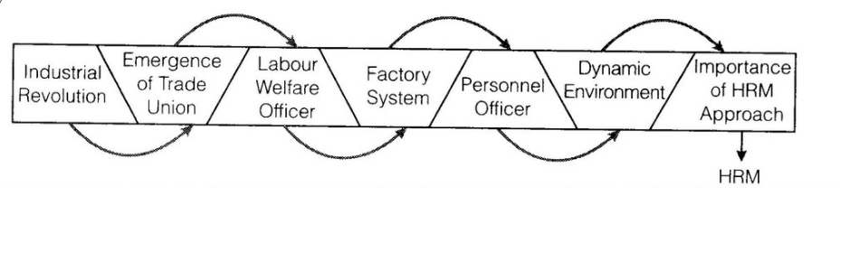
Evolution of Human Resource Managment
Copyright © 2011 Pearson Education, Inc. publishing as Prentice Hall
1–<number>

Slide 6
The Management Process
Planning
Controlling
Organizing
Leading
Staffing
Copyright © 2011 Pearson Education, Inc. publishing as Prentice Hall
1–<number>
Notes:
Human Resources Management 12e
Gary Dessler
Copyright © 2011 Pearson Education, Inc. publishing as Prentice Hall
1–<number>
Most experts agree that managing involves five functions: planning, organizing, staffing, leading, and controlling. In total, these functions represent the management process.

Slide 7
Human Resource Management Processes
Acquisition
Fairness
Training
Human Resource Management (HRM)
Health and Safety
Appraisal
Labor Relations
Compensation
Copyright © 2011 Pearson Education, Inc. publishing as Prentice Hall
1–<number>
Notes:
Human Resources Management 12e
Gary Dessler
Copyright © 2011 Pearson Education, Inc. publishing as Prentice Hall
1–<number>
HRM involves several processes. The topics we’ll discuss will provide you with concepts and techniques needed to perform the “people” or personnel aspects of your job as a manager.

Slide 8
Personnel Aspects of a Manager’s Job
Conducting job analyses
Planning labor needs and recruiting job candidates
Selecting job candidates
Orienting and training new employees
Managing wages and salaries
Providing incentives and benefits
Appraising performance
Communicating
Training and developing managers
Building employee commitment
Copyright © 2011 Pearson Education, Inc. publishing as Prentice Hall
1–<number>
Notes:
Human Resources Management 12e
Gary Dessler
Copyright © 2011 Pearson Education, Inc. publishing as Prentice Hall
1–<number>
Managers are involved daily with many of the personnel aspects of HRM in accomplishing the organization’s goals, and managing the efforts of the organization’s people.

Slide 9
Personnel Mistakes
Hire the wrong person for the job
Experience high turnover
Have your people not doing their best
Waste time with useless interviews
Have your firm in court because of discriminatory actions
Have your firm cited by OSHA for unsafe practices
Have some employees think their salaries are unfair and inequitable relative to others in the organization
Allow a lack of training to undermine your department’s effectiveness
Commit any unfair labor practices
Copyright © 2011 Pearson Education, Inc. publishing as Prentice Hall
1–<number>
Notes:
Human Resources Management 12e
Gary Dessler
Copyright © 2011 Pearson Education, Inc. publishing as Prentice Hall
1–<number>
Why are the concepts and techniques of HRM important to all managers? Perhaps it’s easier to answer this by listing some of the personnel mistakes you don’t want to make while managing.
Carefully studying this book will help you avoid mistakes like these.

Slide 10

Basic HR Concepts
The bottom line of managing:
Getting results
HR creates value by engaging in activities that produce the employee behaviors that the organization needs to achieve its strategic goals.
Looking ahead: Using evidence-based HRM to measure the value of HR activities in achieving those goals.
Copyright © 2011 Pearson Education, Inc. publishing as Prentice Hall
1–<number>
Notes:
Human Resources Management 12e
Gary Dessler
Copyright © 2011 Pearson Education, Inc. publishing as Prentice Hall
1–<number>
Hiring the right people for the right jobs and motivating, appraising, and developing them will likely get the results you are seeking. Remember that success comes through people.

Slide 11

Line and Staff Aspects of HRM
Line Manager
  Is authorized (has line authority) to direct the work of subordinates and is responsible for accomplishing the organization’s tasks.
Staff Manager
  Assists and advises line managers.
  Has functional authority to coordinate personnel activities and enforce organization policies.
Copyright © 2011 Pearson Education, Inc. publishing as Prentice Hall
1–<number>
Notes:
Human Resources Management 12e
Gary Dessler
Copyright © 2011 Pearson Education, Inc. publishing as Prentice Hall
1–<number>
Line managers manage operational functions that are crucial for the company’s survival. Staff managers run departments that are advisory or supportive, like purchasing, HRM, and quality control.
Human resource managers are usually staff managers. They assist and advise line managers with recruiting, hiring, and compensation. However, line managers still have human resource duties.

Slide 12
Line Managers’ HRM Responsibilities
Placing the right person on the right job
Starting new employees in the organization (orientation)
Training employees for jobs that are new to them
Improving the job performance of each person
Gaining creative cooperation and developing smooth working relationships
Interpreting the firm’s policies and procedures
Controlling labor costs
Developing the abilities of each person
Creating and maintaining department morale
Protecting employees’ health and physical condition
Copyright © 2011 Pearson Education, Inc. publishing as Prentice Hall
1–<number>
Notes:
Human Resources Management 12e
Gary Dessler
Copyright © 2011 Pearson Education, Inc. publishing as Prentice Hall
1–<number>
In small organizations, line managers carry out many personnel duties unassisted. As the organization grows, the need arises for the specialized assistance, knowledge, and advice of a human resource department.

Slide 13
Human Resource Managers’ Duties
Functions of
HR Managers
Line Function
Line Authority
Implied Authority
Coordinative
Function
Functional Authority
Staff Functions
Staff Authority
Innovator/Advocacy
Copyright © 2011 Pearson Education, Inc. publishing as Prentice Hall
1–<number>
Notes:
Human Resources Management 12e
Gary Dessler
Copyright © 2011 Pearson Education, Inc. publishing as Prentice Hall
1–<number>
An HR manager directs the activities of the people in the HR department, coordinates organizational-wide personnel activities and provides HRM assistance and advice to line managers.

Slide 14
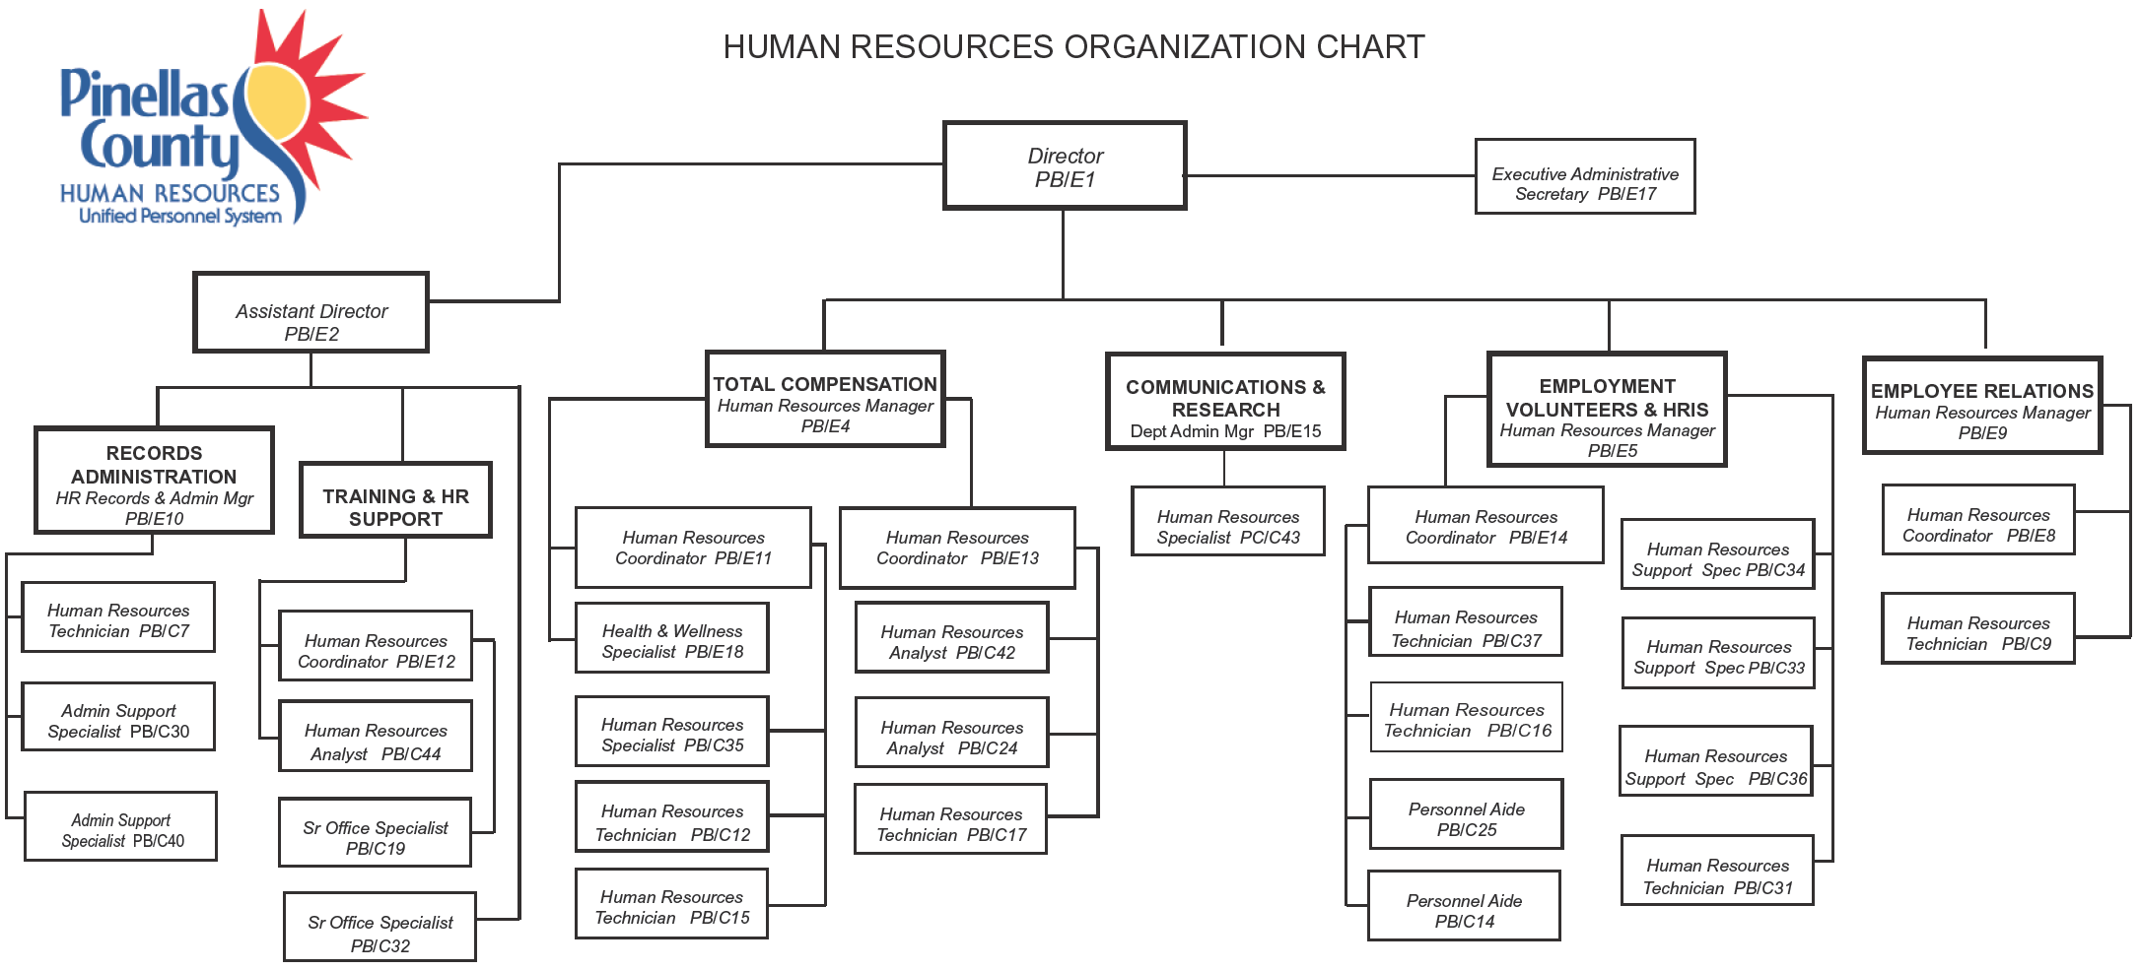
FIGURE 1–1 Human Resources Organization Chart for a Large Organization
Copyright © 2011 Pearson Education, Inc. publishing as Prentice Hall
1–<number>
Notes:
Human Resources Management 12e
Gary Dessler
Copyright © 2011 Pearson Education, Inc. publishing as Prentice Hall
1–<number>
The size of the human resource department reflects the size of the employer. For a very large employer, an organization chart like the one in Figure 1-1 would be typical, containing a full complement of specialists for each HR function.

Slide 15
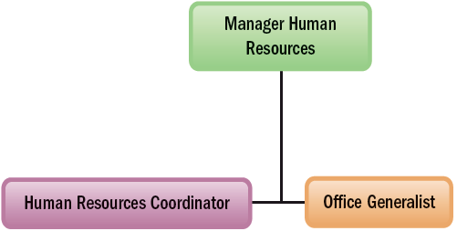
FIGURE 1–2 Human Resources Organization Chart for a Small Company
Copyright © 2011 Pearson Education, Inc. publishing as Prentice Hall
1–<number>
Notes:
Human Resources Management 12e
Gary Dessler
Copyright © 2011 Pearson Education, Inc. publishing as Prentice Hall
1–<number>
The HR team for a small firm may contain just five or six (or fewer) staff, and have an organization similar to that in Figure 1-2. There is generally about one human resource employee per 100 company employees.

Slide 16
Human Resource Specialties
Recruiter
Labor relations specialist
EEO coordinator
Human Resource Specialties
Training specialist
Job analyst
Compensation manager
Copyright © 2011 Pearson Education, Inc. publishing as Prentice Hall
1–<number>
Notes:
Human Resources Management 12e
Gary Dessler
Copyright © 2011 Pearson Education, Inc. publishing as Prentice Hall
1–<number>
• Recruiters search for qualified job applicants.
• Equal employment opportunity (EEO) coordinators investigate and resolve EEO grievances; examine organizational practices for potential violations; and compile and submit EEO reports.
• Job analysts collect and examine information about jobs to prepare job descriptions.
• Compensation managers develop compensation plans and handle the employee benefits program.
• Training specialists plan, organize, and direct training activities.
• Labor relations specialists advise management on all aspects of union–management relations.

Slide 17
New Approaches to Organizing HR
New HR Services Groups
Transactional HR group
Corporate
HR group
Embedded
HR unit
Centers of Expertise
Copyright © 2011 Pearson Education, Inc. publishing as Prentice Hall
1–<number>
Notes:
Human Resources Management 12e
Gary Dessler
Copyright © 2011 Pearson Education, Inc. publishing as Prentice Hall
1–<number>
Employers are experimenting with offering HR services in new ways. For example, some employers organize their HR services around four groups: transactional, corporate, embedded, and centers of expertise.

Slide 18
Trends Shaping Human Resource Management
Globalization
and Competition Trends
Indebtedness (“Leverage”) and Deregulation
Technological Trends
Trends in HR Management
Trends in the Nature of Work
Workforce and Demographic Trends
Economic Challenges and Trends
Copyright © 2011 Pearson Education, Inc. publishing as Prentice Hall
1–<number>
Notes:
Human Resources Management 12e
Gary Dessler
Copyright © 2011 Pearson Education, Inc. publishing as Prentice Hall
1–<number>
Some trends shaping human resource management practices include globalization, technology, deregulation, debt or “leverage,” changes in demographics and the nature of work, and economic challenges.

Slide 19
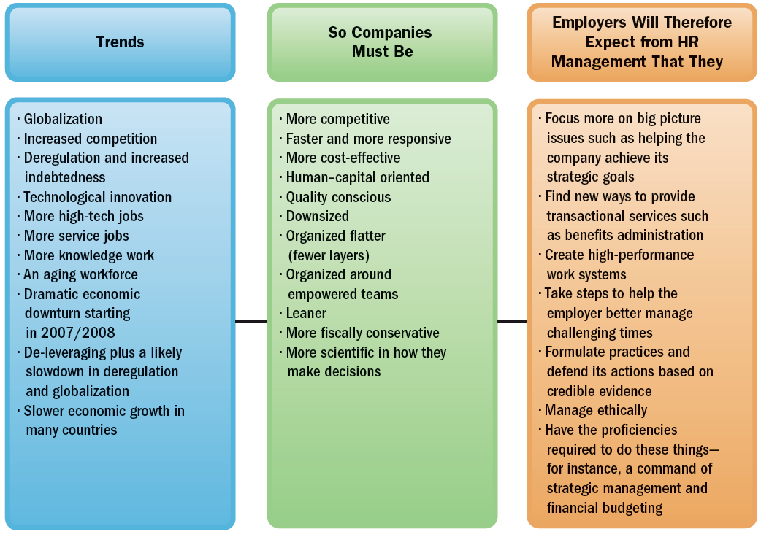
FIGURE 1–4 Trends Shaping Human Resource Management
Copyright © 2011 Pearson Education, Inc. publishing as Prentice Hall
1–<number>
Notes:
Human Resources Management 12e
Gary Dessler
Copyright © 2011 Pearson Education, Inc. publishing as Prentice Hall
1–<number>
Trends shaping HRM are summarized in Figure 1-4.

Slide 20
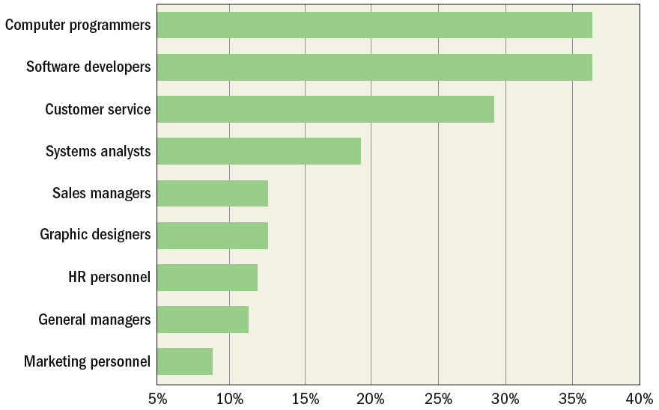
FIGURE 1–5 Employment Exodus: Percent of employers who said they
planned as of 2008 to offshore a number of these jobs
Copyright © 2011 Pearson Education, Inc. publishing as Prentice Hall
1–<number>
Notes:
Human Resources Management 12e
Gary Dessler
Copyright © 2011 Pearson Education, Inc. publishing as Prentice Hall
1–<number>
Figure 1-5 illustrates that in the next few years, many employers plan to offshore even highly skilled jobs such as sales managers, general managers—and HR managers.

Slide 21
Trends in the Nature of Work
Changes in How We Work
High-Tech
Jobs
Service
Jobs
Knowledge Work and Human Capital
Copyright © 2011 Pearson Education, Inc. publishing as Prentice Hall
1–<number>
Notes:
Human Resources Management 12e
Gary Dessler
Copyright © 2011 Pearson Education, Inc. publishing as Prentice Hall
1–<number>
Technology has also had a huge impact on how people work, and on the skills and training today’s workers need. Jobs are becoming more high tech, less-labor intensive, and require more knowledge and higher skill levels (human capital).

Slide 22

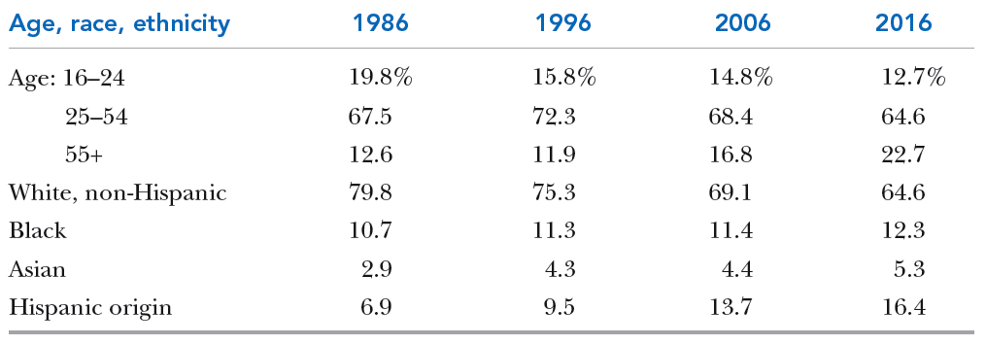
TABLE 1–1 Demographic Groups as a Percent of the Workforce, 1986–2016
Copyright © 2011 Pearson Education, Inc. publishing as Prentice Hall
1–<number>
Notes:
Human Resources Management 12e
Gary Dessler
Copyright © 2011 Pearson Education, Inc. publishing as Prentice Hall
1–<number>
Table 1-1, from the U.S. Department of Labor’s Bureau of Labor Statistics, shows how quickly the U.S. workforce is becoming older and more multi-ethnic.

Slide 23
Workforce and Demographic Trends
Demographic Trends
Trends Affecting Human Resources
Generation “Y”
Retirees
Nontraditional Workers
Copyright © 2011 Pearson Education, Inc. publishing as Prentice Hall
1–<number>
Notes:
Human Resources Management 12e
Gary Dessler
Copyright © 2011 Pearson Education, Inc. publishing as Prentice Hall
1–<number>
Demographic trends are making finding, hiring, and supervising employees more challenging.

Slide 24
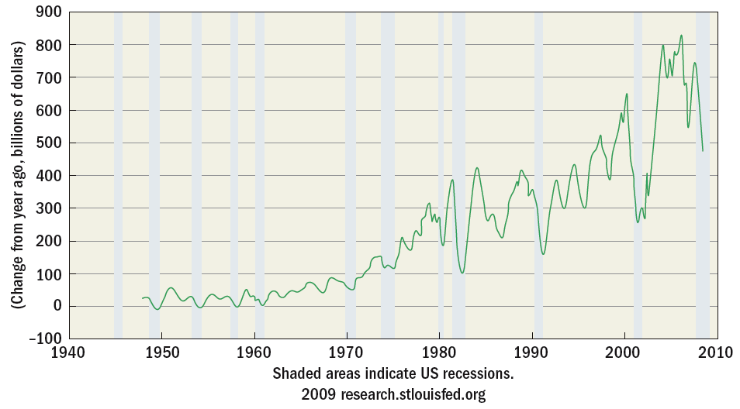
FIGURE 1–6 Gross National Product (GNP)
Copyright © 2011 Pearson Education, Inc. publishing as Prentice Hall
1–<number>
Notes:
Human Resources Management 12e
Gary Dessler
Copyright © 2011 Pearson Education, Inc. publishing as Prentice Hall
1–<number>
In Figure 1-6, the gross national product (GNP)—a measure of the United States of America’s total output—boomed between 2001 and 2007.

Slide 25
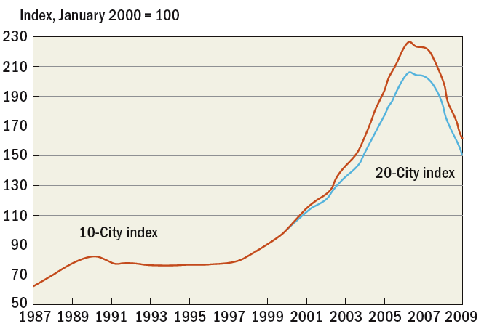
FIGURE 1–7 Case-Shiller Home Price Indexes
Copyright © 2011 Pearson Education, Inc. publishing as Prentice Hall
1–<number>
Notes:
Human Resources Management 12e
Gary Dessler
Copyright © 2011 Pearson Education, Inc. publishing as Prentice Hall
1–<number>
Figure 1-7 shows that home prices leaped as much as 20% per year between 2001 and 2007.

Slide 26
Important Trends in HRM
The New HR Managers
Strategic
HRM
High-Performance Work Systems
Human Resource Management Trends
Evidence-Based HRM
Managing
Ethics
HR
Certification
Copyright © 2011 Pearson Education, Inc. publishing as Prentice Hall
1–<number>
Notes:
Human Resources Management 12e
Gary Dessler
Copyright © 2011 Pearson Education, Inc. publishing as Prentice Hall
1–<number>
Trends like these translate into changes in HRM practices, and in what employers expect from their human resource managers.

Slide 27
Meeting Today’s HRM Challenges
The New Human Resource Managers
Focus more on “big picture” (strategic) issues
Find new ways to provide transactional services
Acquire broader business knowledge and new HRM proficiencies
Copyright © 2011 Pearson Education, Inc. publishing as Prentice Hall
1–<number>
Notes:
Human Resources Management 12e
Gary Dessler
Copyright © 2011 Pearson Education, Inc. publishing as Prentice Hall
1–<number>
HR managers can play big roles in strategic planning and management by helping the top managers in devising functional and departmental plans that support the organization’s overall strategic plan, and then assisting in execution of the plans.

Slide 28
TABLE 1–2 Some Technological Applications to Support HR
Technology | How Used by HR
Application service providers (ASPs) and technology outsourcing | ASPs provide software application, for instance, for processing employment applications. The ASPs host and manage the services for the employer from their own remote computers
Web portals | Employers use these, for instance, to enable employees to sign up for and manage their own benefits packages and to update their personal information
Streaming desktop video | Used, for instance, to facilitate distance learning and training or to provide corporate information to employees quickly and inexpensively
Internet- and network-monitoring software | Used to track employees’ Internet and e-mail activities or to monitor their performance
Electronic signatures | Legally valid e-signatures that employers use to more expeditiously obtain signatures for applications and record keeping
Electronic bill presentment and payment | Used, for instance, to eliminate paper checks and to facilitate payments to employees and suppliers
Data warehouses and computerized analytical programs | Help HR managers monitor their HR systems. For example, they make it easier to assess things like cost per hire, and to compare current employees’ skills with the firm’s projected strategic needs
Copyright © 2011 Pearson Education, Inc. publishing as Prentice Hall
1–<number>
Notes:
Human Resources Management 12e
Gary Dessler
Copyright © 2011 Pearson Education, Inc. publishing as Prentice Hall
1–<number>
Table 1-2 lists some important ways employers use technology to support their HRM activities.

Slide 29
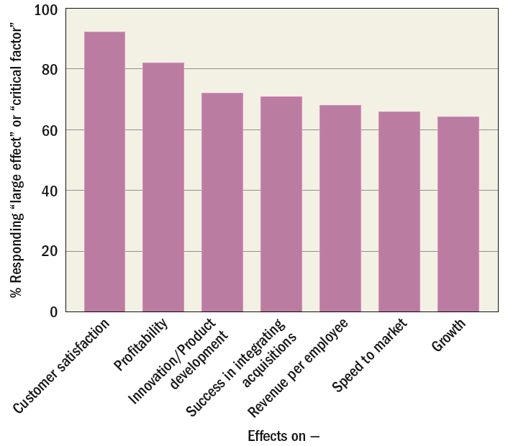
FIGURE 1–8 Effects CFOs Believe Human Capital Has on Business Outcomes
Copyright © 2011 Pearson Education, Inc. publishing as Prentice Hall
1–<number>
Notes:
Human Resources Management 12e
Gary Dessler
Copyright © 2011 Pearson Education, Inc. publishing as Prentice Hall
1–<number>
Figure 1-8 summarizes how human capital—the employees’ knowledge, skills, and experiences—can have a big effect on important organizational outcomes, such as customer satisfaction and profitability.

Slide 30

High-Performance Work Systems
Increase productivity and performance by:
  Recruiting, screening and hiring more effectively
  Providing more and better training
  Paying higher wages
  Providing a safer work environment
  Linking pay to performance
Copyright © 2011 Pearson Education, Inc. publishing as Prentice Hall
1–<number>
Notes:
Human Resources Management 12e
Gary Dessler
Copyright © 2011 Pearson Education, Inc. publishing as Prentice Hall
1–<number>
A high-performance work system is a set of HRM policies and practices that together produce superior employee performance.

Slide 31
Evidence-Based HRM
Providing Evidence for HRM Decision Making
Actual measurements
Existing
data
Research
studies
Copyright © 2011 Pearson Education, Inc. publishing as Prentice Hall
1–<number>
Notes:
Human Resources Management 12e
Gary Dessler
Copyright © 2011 Pearson Education, Inc. publishing as Prentice Hall
1–<number>
Evidence-based HRM is the deliberate use of the best-available evidence in making decisions about the human resource management practices you are focusing on.

Slide 32

Managing Ethics
Ethics
  Standards that someone uses to decide what his or her conduct should be
HRM-related Ethical Issues
  Workplace safety
  Security of employee records
  Employee theft
  Affirmative action
  Comparable work
  Employee privacy rights
Copyright © 2011 Pearson Education, Inc. publishing as Prentice Hall
1–<number>
Notes:
Human Resources Management 12e
Gary Dessler
Copyright © 2011 Pearson Education, Inc. publishing as Prentice Hall
1–<number>
Every line manager or human resource manager needs to keep in mind the ethical implications of his or her employee-related decisions.

Slide 33

HR Certification
HR is becoming more professionalized.
Society for Human Resource Management (SHRM)
  SHRM’s Human Resource Certification Institute (HRCI)
    SPHR (Senior Professional in HR) certificate
    GPHR (Global Professional in HR) certificate
    PHR (Professional in HR) certificate
Copyright © 2011 Pearson Education, Inc. publishing as Prentice Hall
1–<number>
Notes:
Human Resources Management 12e
Gary Dessler
Copyright © 2011 Pearson Education, Inc. publishing as Prentice Hall
1–<number>
As the human resource manager’s job becomes more demanding, HRM is becoming more professionalized. The Society for Human Resource Management’s (SHRM) HR professional certification exams test the HR professional’s knowledge of all aspects of HRM.

Slide 34
The Plan of This Book: Basic Themes
HRM is the responsibility of every manager.
The workforce is becoming increasingly diverse.
Current economic challenges require that HR managers develop new and better skills to effectively and efficiently deliver and manage HR services.
The intensely competitive nature of business today means human resource managers must defend their plans and contributions in measurable terms.
Copyright © 2011 Pearson Education, Inc. publishing as Prentice Hall
1–<number>
Notes:
Human Resources Management 12e
Gary Dessler
Copyright © 2011 Pearson Education, Inc. publishing as Prentice Hall
1–<number>
In this book, we’ll use several themes and features to emphasize particularly important issues, and to provide continuity from chapter to chapter.

Slide 35
FIGURE 1–10 Strategy and the Basic Human Resource Management Process
Copyright © 2011 Pearson Education, Inc. publishing as Prentice Hall
1–<number>
Notes:
Human Resources Management 12e
Gary Dessler
Copyright © 2011 Pearson Education, Inc. publishing as Prentice Hall
1–<number>
In practice, don’t think of each of this book’s 18 chapters and topics as being unrelated to the others. Each topic interacts with and affects the others, and all should align with the employer’s strategic plan. Figure 1-10 summarizes this idea.

Slide 36
K E Y T E R M S
organization
manager
management process
human resource management (HRM)
authority
line authority
staff authority
line manager
staff manager
functional authority
globalization
human capital
Copyright © 2011 Pearson Education, Inc. publishing as Prentice Hall
1–<number>
Notes:
Human Resources Management 12e
Gary Dessler
Copyright © 2011 Pearson Education, Inc. publishing as Prentice Hall
1–<number>

Slide 37

All rights reserved. No part of this publication may be reproduced, stored in a retrieval system, or transmitted, in any form or by any means, electronic, mechanical, photocopying, recording, or otherwise, without the prior written permission of the publisher. Printed in the United States of America.
Copyright © 2011 Pearson Education, Inc. publishing as Prentice Hall
1–<number>
Notes:
Human Resources Management 12e
Gary Dessler
Copyright © 2011 Pearson Education, Inc. publishing as Prentice Hall
1–<number>

